Slide 1


LHCb asymmetries internship
Summer 2022
Artemis Bouzaki and Daniil Kruklinskii

Slide 2
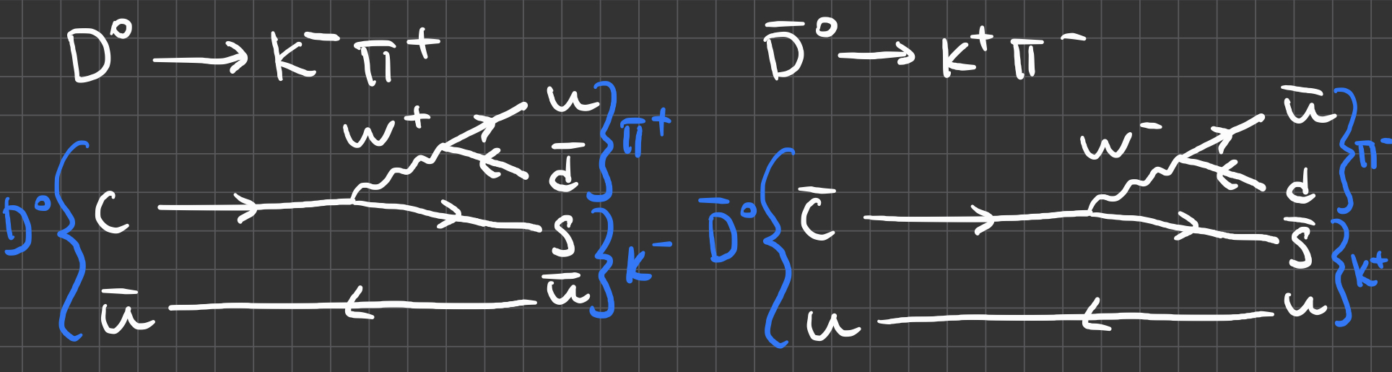

Aim
Find raw asymmetry in $D^{0}→Kπ$ decays
Calculate $K^{±}π^{∓}$ detection asymmetry
Thus, deduce production asymmetry of $D^{0}$ and ${\overline{D}}^{0}.$
Figure 1. Feynmann diagrams of $D^{0}→Κ^{−}π^{+}$ and ${\overline{D}}^{0}→Κ^{+}π^{−}$ decays.

Slide 3

Raw asymmetry (1)
Extra cuts applied to both tracks: $P_{z}>0$, isMuon = False
$$A_{raw}=\frac{N_{D^{0}}−N_{{\overline{D}}^{0}}}{N_{D^{0}}+N_{{\overline{D}}^{0}}}$$
Statistical uncertainty calculated from
$σ_{Α}= \sqrt{\frac{1−A_{raw}^{2}}{N_{D^{0}}+N_{{\overline{D}}^{0}}}}$
Background models attempted: straight line, exponential
Signal models attempted: JohnsonSU, Crystal Ball, Gaussians (and their combinations)
Best model chosen based on $χ^{2}$ value and residuals

Slide 4
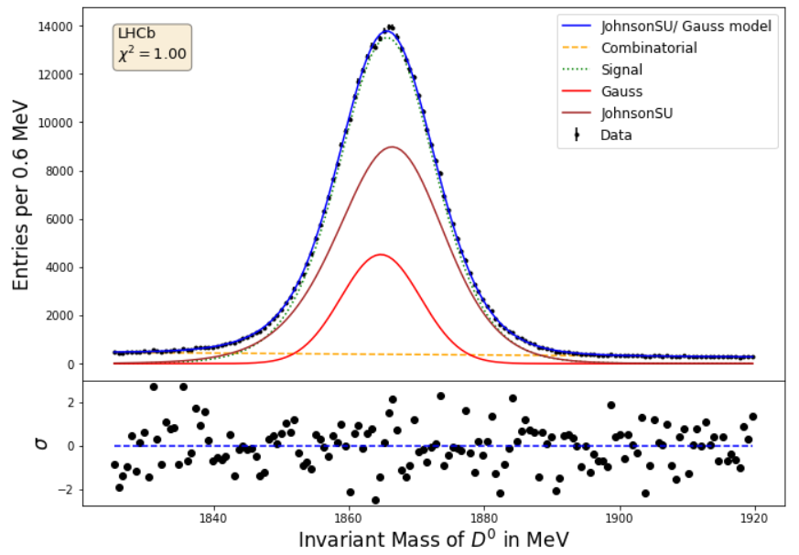
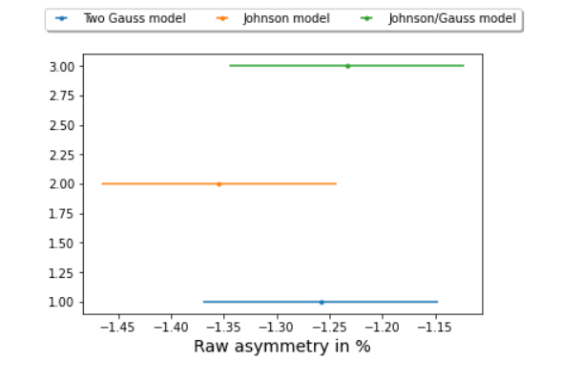

Raw asymmetry (2)
Figure 2. $D^{0}$ mass fit used to calculate raw asymmetry for 2018 MagDown data. Gave $A_{raw}=−1.23 ±0.11.$
Figure 3. Different models for 2018 MagDown data and their asymmetry outputs.

Slide 5
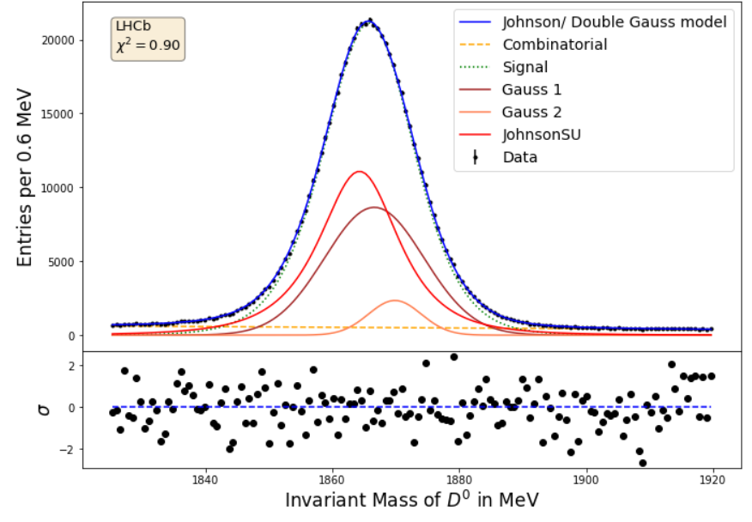

Raw asymmetry (3)
Figure 4. $D^{0}$ mass fit used to calculate raw asymmetry for 2018 MagUp data. Gave $A_{raw}=−0.85 ±0.09.$

Slide 6

Raw asymmetry (4)
Figure 5. $D^{0}$ mass fits used to calculate raw asymmetry for 2018 MagUp data. Straight line for background (left) and exponential background (right). Mean for JohnsonSU was fixed at 1865.68 MeV. Exponential, JohnsonSU, Gaussian (right) gave
$$A_{raw}\text{ = }\text{−}\text{1}\text{.}\text{3}\text{3}±\text{0.0}\text{9}$$
$.$

Slide 7
Raw asymmetry (5)
Figure 6. Different models for 2018 MagUp data and their asymmetry outputs in decimals (around -1.3%)

Slide 8

Detection asymmetry
$A_{det}\left(K^{+}π^{−}\right)=$ $A\left(K_{s}^{0}π^{+}\right)−A\left(D^{+}→K^{−}π^{+}π^{+}\right)−A(K_{s}^{0})$
Used code updated by Yunlong Li which uses three step weighting process*
Code outputs $A\left(D^{+}→K^{−}π^{+}π^{+}\right)$, $A\left(K_{s}^{0}π^{+}\right)$
Known value $A\left(K_{s}^{0}\right)=0.054 ±0.014$ **
For 2018 magup :${ A}_{det}(K^{+}π^{−})=0.41 ± 0.29$
For 2018 magdown:${ A}_{det}(K^{+}π^{−})=0.73 ± 0.30$ (using reweighting)
$A_{det}(K^{+}π^{−})=0.41 ± 0.29$ (skip reweighting/using same reweighting as magup)
* https://gitlab.cern.ch/liyu/asld_analysis//tree/master/kpi_asymmetry/AsymmetryTools
** https://cds.cern.ch/record/2284097/files/LHCb-INT-2017-023.pdf

Slide 9

Production asymmetry
$D^{0}→Kπ$ is Cabbibo favoured channel – no CP violation expected
Thus, $A_{prod}= A_{raw}−A_{det}(K^{+}π^{−})$
Or $A_{prod}=A_{raw}+A\left({D^{+}→K}_{s}^{0}π^{+}\right)−A\left(D^{+}→K^{−}π^{+}π^{+}\right)−A(K_{s}^{0})$
For 2018 MagDown : $A_{prod}=−0.51 ±$ 0.32 (stat) (Line/Johnson/Double Gauss)
For 2018 MagUp: $A_{prod}=−0.55 ±$ 0.31 (stat) (Line/Johnson/Double Gauss)
$A_{prod}=−1.03 ±$ 0.30(stat) $±$ 0.01(syst) (Exp/Johnson/Gauss)
2924

Slide 10
Future suggestions
Attempt more sophisticated models for mass fits
Analyse data from previous years for both polarities

